Slide 1

OPTIMIZING TASK MANAGEMENT WITH ROUND ROBIN SCHEDULING
LAVANYA R(192210663)
PRADEESH GURU A(192210636) AND CHALLA VENKATA SAI(192110660)

Slide 2
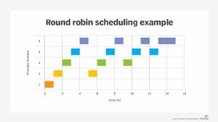
ABSTRACT
A round robin is an arrangement of choosing all elements in a group equally in some rational order, usually from the top to the bottom of a list and then starting again at the top of the list and so on. Round Robin (RR) scheduling algorithm is widely used scheduling algorithm in multitasking.
It ensures fairness and starvation free execution of processes. Choosing the time quantum in RR is very crucial as small time slice results in large number of context switches and large time quantum increases the response time.
Experiment analysis reveals that the proposed algorithm produces better average turnaround time, average waiting time and fewer number of context switches than existing algorithms.

Slide 3
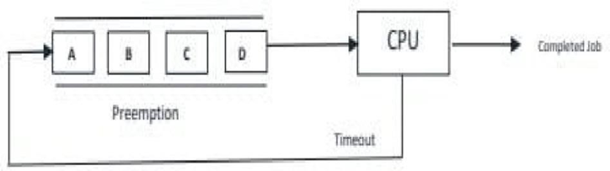
OBJECTIVE
Round Robin (RR) scheduling is a widely used CPU scheduling algorithm designed to allocate CPU time to processes in a fair manner.
It operates on a time-sharing principle, ensuring that each process receives a fixed time slice, or quantum, to execute
. This approach prevents any single process from monopolizing the CPU, thus enhancing system responsiveness and efficiency, particularly in time-sharing systems.
Round Robin (RR) scheduling algorithm

Slide 4
INTRODUCTION
Round Robin scheduling algorithm is one of the most popular scheduling algorithm which can actually be implemented in most of the operating systems. This is the preemptive version of first come first serve scheduling. The Algorithm focuses on Time Sharing. In this algorithm, every process gets executed in a cyclic way. Round Robin is a CPU scheduling algorithm where each process is assigned a fixed timeslot in a cyclic way.
It is simple, easy to implement. And starvation free as all processes get fair share of CPU. One of the most commonly used technique in CPU scheduling as a core. Itis pre- emptive as processes are assigned CPU only for a fixed slice of time at the most.
The disadvantage of it is more overhead of context switching. Each process gets equal priority and fair allocation of CPU. Round Robin scheduling algorithm enables the Context switching method to save the states of preempted processes. It is easily implementable on the system because round robin scheduling in os doesn't depend upon burst time.

Slide 5
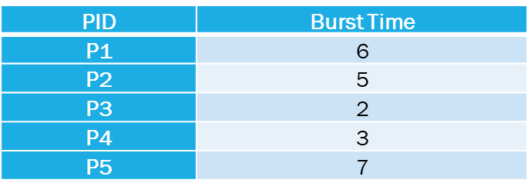
EXAMPLE OF ROUND ROBIN SCHEDULING ALGORITHM
Assume there are 5 processes with process ID and burst time given below
Time quantum=2.
Assume that all process arrives at 0.
Now, We will calculate average waiting time for this process to complete.
SOLUTION
We can represent execution of above processes using GANTT chart as
shown below
GANTT CHART
P1 | P2 | P3 | P4 | P5 | P1 | P2 | P4 | P5 | P1 | P2 | P5
0 2 4 6 8 10 12 14 15 17 19 20 23

Slide 6
ADVANTAGES OF ROUND ROBIN ALGORITHM
No issues of starvation or convoy effect.
Every job gets a fair allocation of CPU.
No priority scheduling is involved.
Total number of processes on the run queue helps assume the worst-case response time for a process.
Doesn't depend on burst time and is easily implementable.

Slide 7
DISADVANTAGES OF ROUND ROBIN ALGORITHM
Low slicing time reduces processor output.
Spends more time on context switching.
Performance depends on time quantum.
Decreases comprehension.
Higher context switching overhead due to lower time quantum.

Slide 8
AREA OF FUTURE IMPROVEMENT
We can improve performance for round robin by arranging processes in an increasing order according to the burst time, then calculating the mean of the burst time as quantum time finally calculating turnaround time and waiting time, thus to obtain better results comparing with the standard RR.

Slide 9
CONCLUSION
Round Robin scheduling remains a cornerstone of CPU scheduling algorithms due to its straightforward implementation and balanced approach to process management. Its effectiveness is contingent upon the appropriate selection of the quantum size, which directly impacts system performance.
Ongoing research and enhancements aim to refine RR scheduling, ensuring its continued relevance in modern operating systems. By understanding and addressing its limitations, RR can be adapted to meet the evolving demands of computing environments.

Slide 10
THANK YOU

